Slide 1

Heartbeat ECG Classification
Kevin Juandi
University of Colorado Boulder

Slide 2
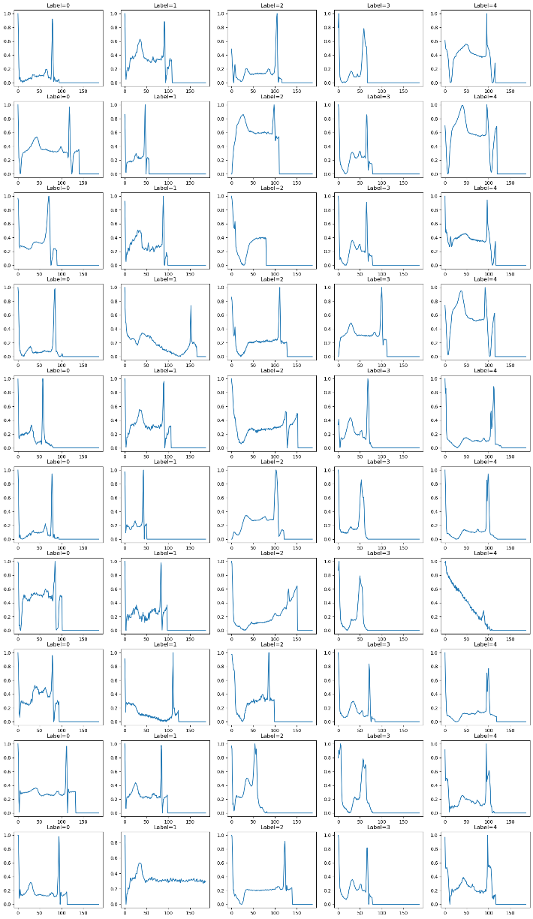
Abstract
The purpose of this project is to train models with classification algorithm to predict various types of cardiac arrhythmias based on ECG Data.
An ECG (Electrocardiogram) is a medical test that records the electrical signals in the heart.
Github repo: https://github.com/Chiuchiyin/DTSA5509-Final-Project

Slide 3
Introduction
Our dataset is taken from Kaggle
https://www.kaggle.com/datasets/shayanfazeli/heartbeat
Each observation in the dataset represents a single heartbeat on an ECG
It is sampled at 125 Hz with 187 total points per observation. These time series points serve as the features of our dataset.
Many of these heartbeats are padded with zeros at the end if they lasted for less than 1.5 seconds.
Each observation is classified into one of five categories.

Slide 4
Each observation is classified into one of five categories:
0 = Non-ectopic (Normal)
1 = Supra Ventricular Ectopic (S)
2 = Ventricular Ectopic (V)
3 = Fusion (F)
4 = Unclassifiable (Q)

Slide 5
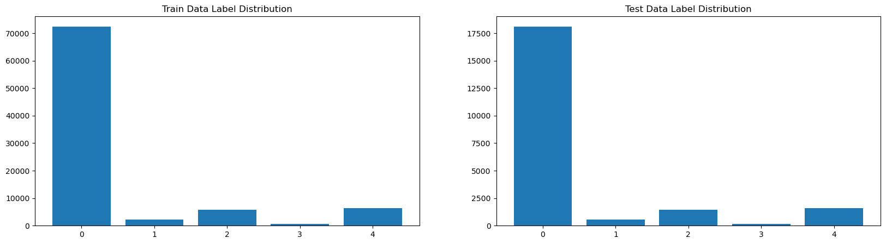
Preprocessing
We have 87554 rows of training data and 21892 rows of test data
Dataset is too large
Imbalanced dataset ~83% category 0
Stratified Sampling
Weighted Sampling

Slide 6
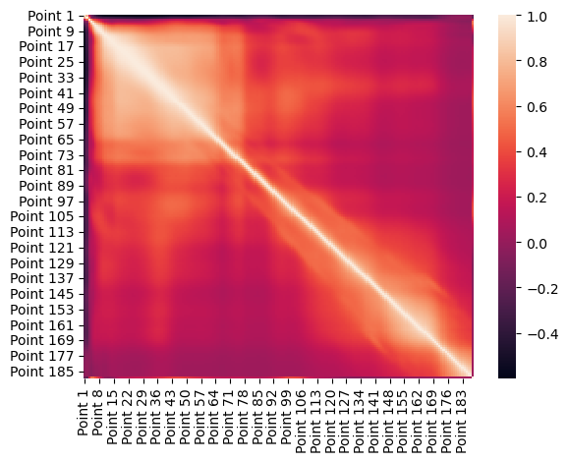
Heatmap
Strong correlation in the first ~30%
Little to no correlation in the later points
High correlation between neighbouring points

Slide 7
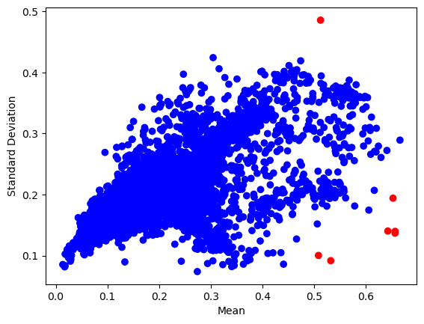
Outlier Detection

Slide 8
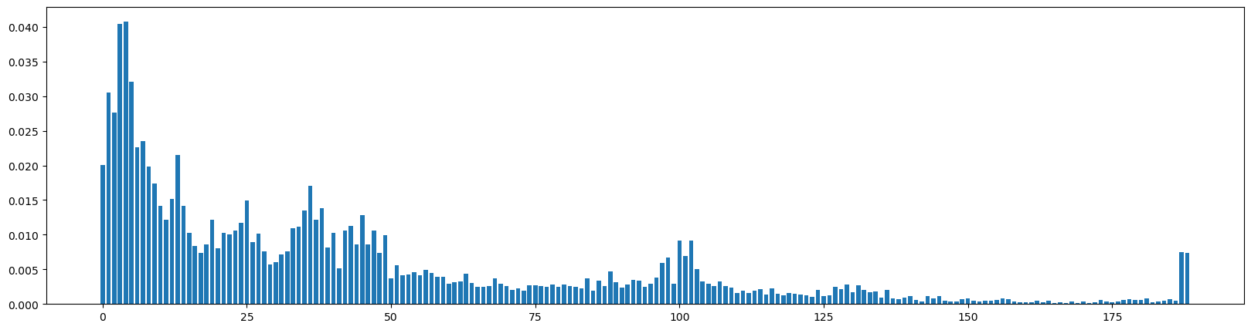
Feature selection
Train random forest model
Extract feature importance

Slide 9
Machine Learning Algorithm
KNN
Random Forest
Gradient Boost
SVM
Github repo: https://github.com/Chiuchiyin/DTSA5509-Final-Project

Slide 10
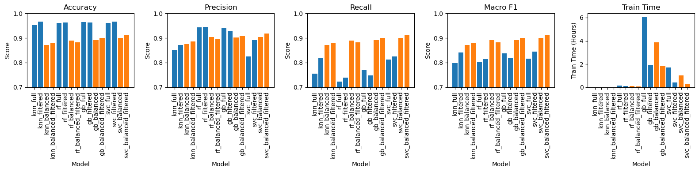
Evaluation
Metrics used:
Accuracy
Precision
Recall
Macro F1
Training Time

Slide 11
Summary
We sampled the data
We explored and understand the data with EDA
We used clustering algorithm to detect outliers
We trained random forest and extract it’s feature importance to be used for feature selection
We trained 4 models on each dataset
The model that performed the best was SVM trained with balanced dataset using feature selection.

Slide 12
Discussion
Is our model useful?
Can we make it better?

